Slide 1
DEPI Orientation
Round 3 – June 2025

Slide 2


Who Am I ? Eng. Baraa Abu Sallout - Palestinian From Gaza
Bachelor's and Master's in Computer Engineering
AI Solutions Engineer & Business Empowerment Specialist
AI Development Consultant
Data Scientist
Expert Trainer & Consultant (Work in DEPI R1,R2 with 8 Groups)
Human & Mentor
Lifelong Learner
Linkedin Link

Slide 3
NOW,,
Who are you?
Why are you here?
What’s your university major? Are you working right now or not?
If you're working, what do you do?

Slide 4
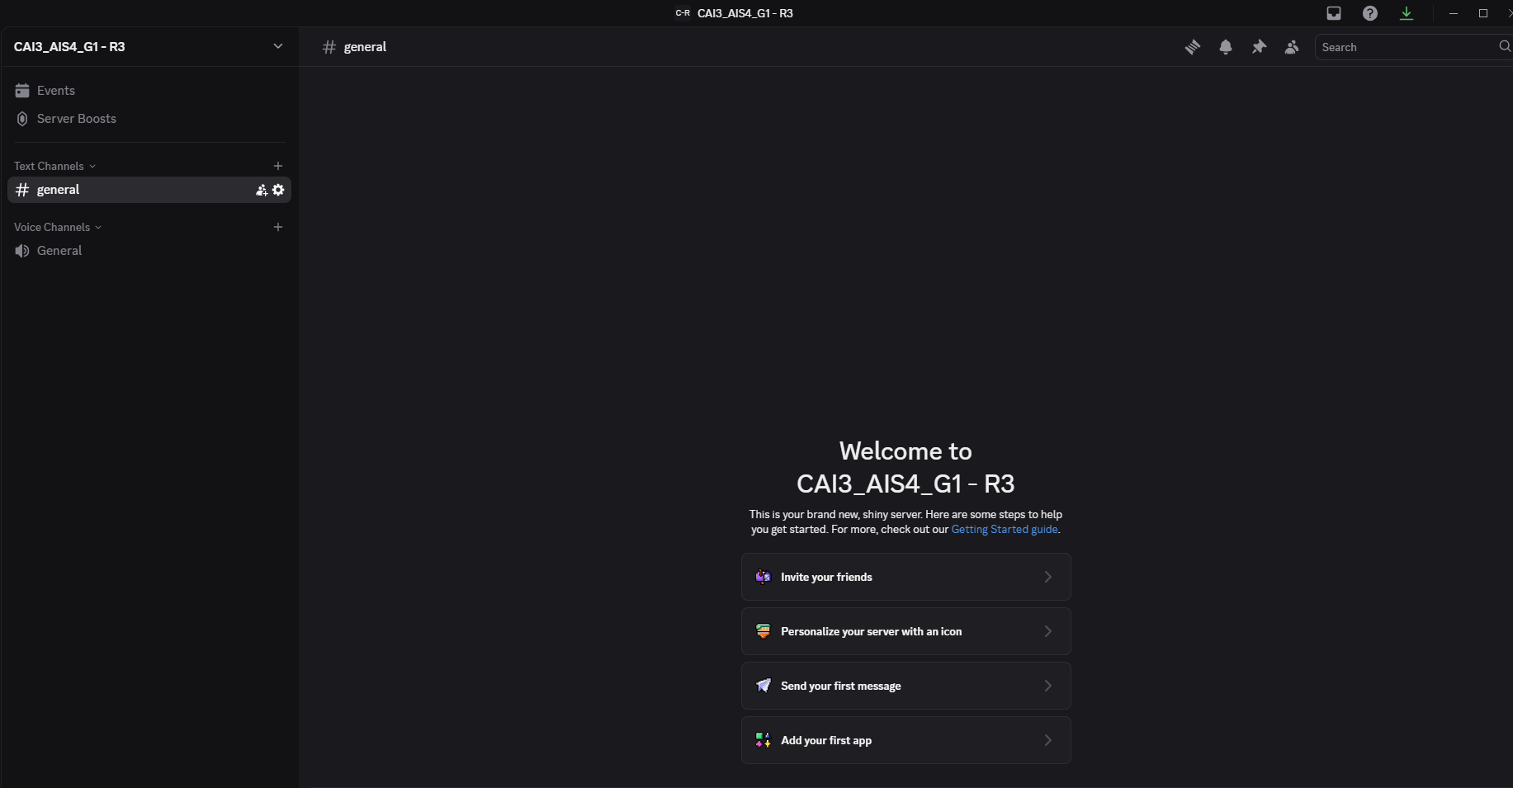
Discord

Slide 5
You must know
Students Team Leader ???
Company Admin Contact
Ticketing System
Communication

Slide 6

Time is divided between
Group sessions: we explain new concepts (aka 'theory')
Practise sessions: you work on exercises or case studies or projects
Interactive sessions: encompass a range of activities aimed at hands-on learning and practical experience.
In case of questions, remarks, suggestions, you can always interrupt us and just ask.
Feel lost?
Please stop me Just ask, We are here to help you.

Slide 7
Our Rule of sessions
Students are expected to join sessions on time.
Interactive, Interactive, Interactive.
Questions Outside the Session in Discord.
Assignments and small projects must be submitted on time.
Random surprise questions during the session 😁 (don’t answer be marked as absent.)

Slide 8
Orientation – DEPI

Slide 9
Academic Model
Profile
Sessions
Evaluation
Presentation
Quiz
Assignment
Assessments
Final Assessment

Slide 10
Mark your Timeline
Announcement of Profile Detailed Syllabus
W5
W7
W8
W10
W15
W18
W20
Assessment 1
(10 Sessions)
Assessment 2
(25 Sessions)
Project Announcement
Project Group Formation
Project
Break-down
Project Prototype
Project Final Presentation

Slide 11

DEPI Objectives
Developing technological pioneers in modern technologies among students and graduates, especially software development pioneers, artificial intelligence, data science, business analysis, cybersecurity, digital arts, and others.
Providing the appropriate environment for students and graduates to start their own businesses on freelance platforms.
Qualifying students and graduates to join distinguished jobs in the field of information and communications technology.

Slide 12
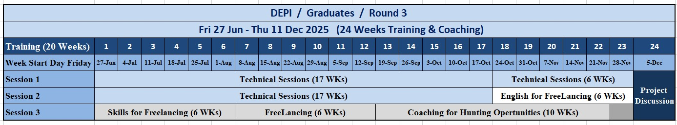
4:10 PM break

Slide 13
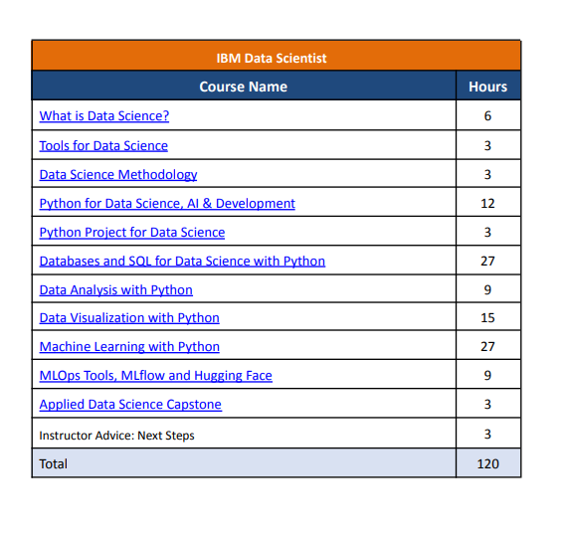
IBM Data Scientist
IBM Data Science Syllabus

Slide 14
Pre Assessment

Slide 15
My Advice for New Data Scientists
Use curiosity to fuel problem-solving
Master the basics
Work on real projects
Embrace failure
Learn to tell the story
Never stop learning
Build your network
Be adaptable
Focus on quality, not just quantity
Always think about added value
Be solution-oriented, not tool-oriented
Share your work and learn from others
24

Slide 16
Good Luck Thank you

